Slide 1

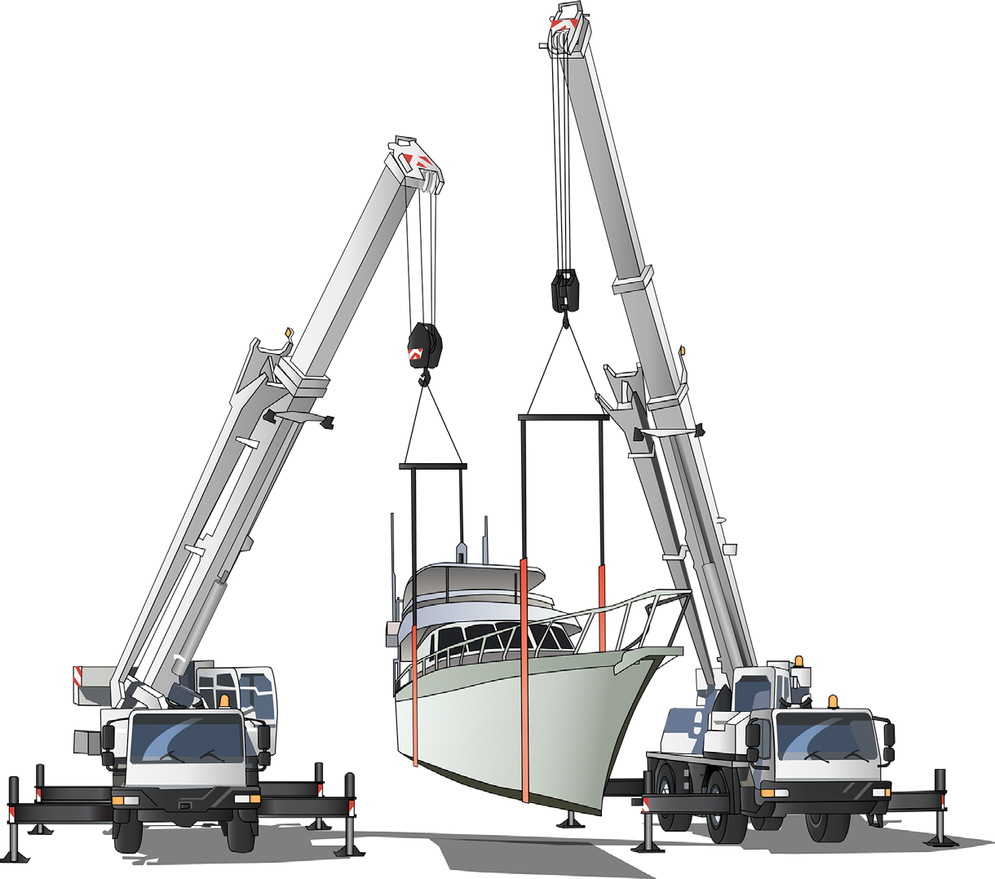

RIGGING INTERMEDIATE FINAL REVIEW STUDY GUIDE
Training support material for:
CPCCLRG3002A –
Licence to perform rigging
intermediate level
Produced by:

Slide 2
Contents
How to use this guide
Language – Literacy – Numeracy (LLN) Acknowledgements
Introduction to intermediate rigging High risk licensing and the law
4
5
7
9
11
17
45
51
85
111
133
Element 1
Element 2
Element 3
Element 4
Element 5
Plan job
Select and inspect equipment Set up tasks
Erect structures and plant Dismantle structures and plant
Test yourself – Learning tasks

Slide 3
Introduction to rigging intermediate

Slide 4
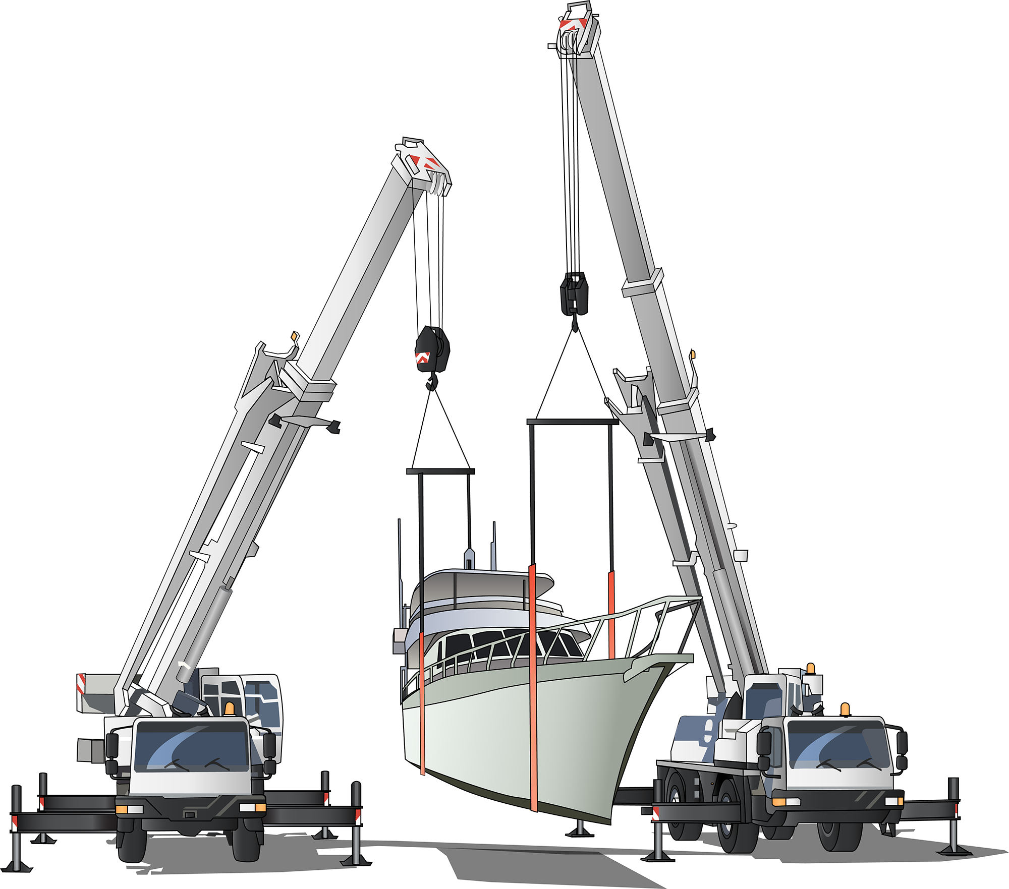
What is intermediate rigging?
INTRODUCTION TO INTERMEDIATE RIGGING
Intermediate rigging covers all the work done by riggers at the basic level, and also includes:
Rigging of cranes
Rigging of conveyors
Rigging of dredges and excavators
Rigging tilt slabs
Demolition work
Dual crane lifts.
Intermediate rigging includes using mechanical load shifting equipment to move, place or secure a load. It also involves using plant, equipment or part of a structure/building to set up and dismantle cranes and hoists.
Prerequisite
CPCCLRG3001A
Licence to perform rigging basic level
A valid licence for basic rigging (RB)

Slide 5


plan job
Element 1

Slide 6
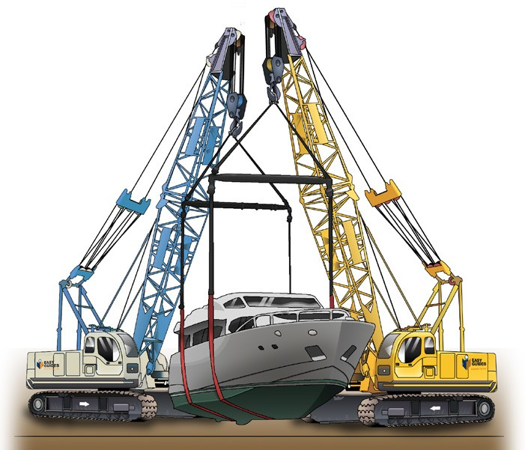
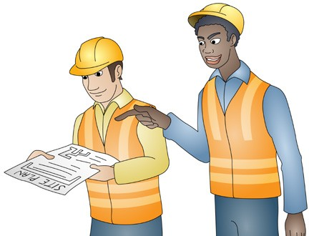
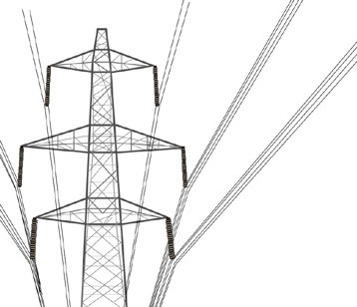
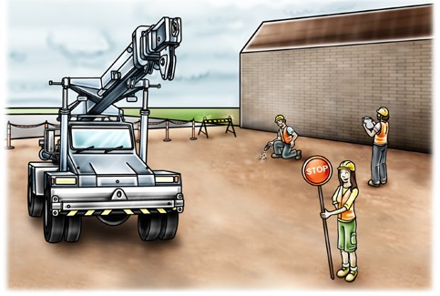
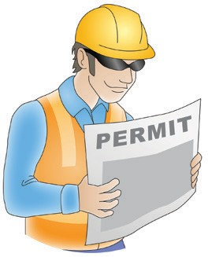
PC 1.1
PLAN JOB
QUESTION 8
What kind of jobs can an intermediate rigger legally do?
Any rigging work to do with:
erecting cranes, excavators, conveyors and dredges
erecting hoists
self-climbing hoists
erecting tilt slabs, pre-cast and tilt up concrete panels
demolition work
overseeing dual/multiple crane lifts
All work that a basic rigger can do.
QUESTION 9
You will plan for site hazards later.
What other things do you plan for before starting
a task?
Where is the job?
Things you must know about the site.
For example, are powerlines nearby?
How will you get in and out of the site?
What permits do you need for the task?
...CONTINUES ON NEXT PAGE

Slide 7
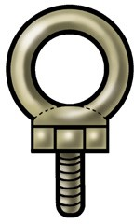
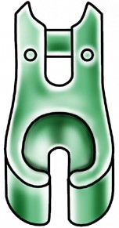
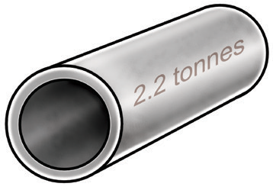
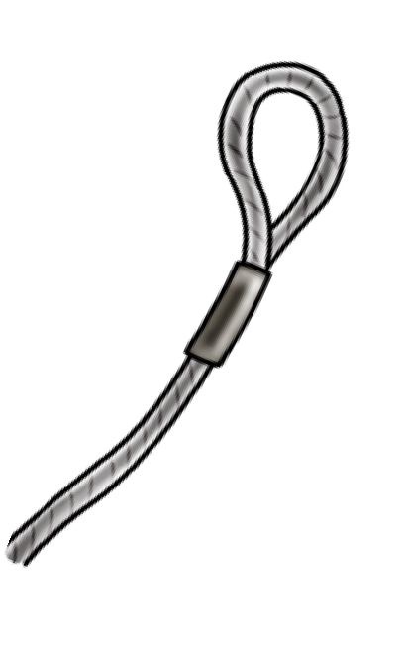
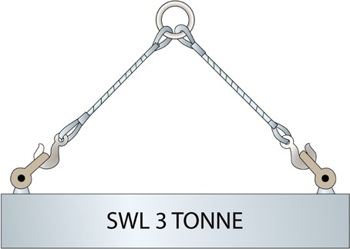
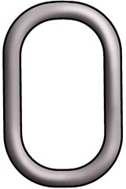
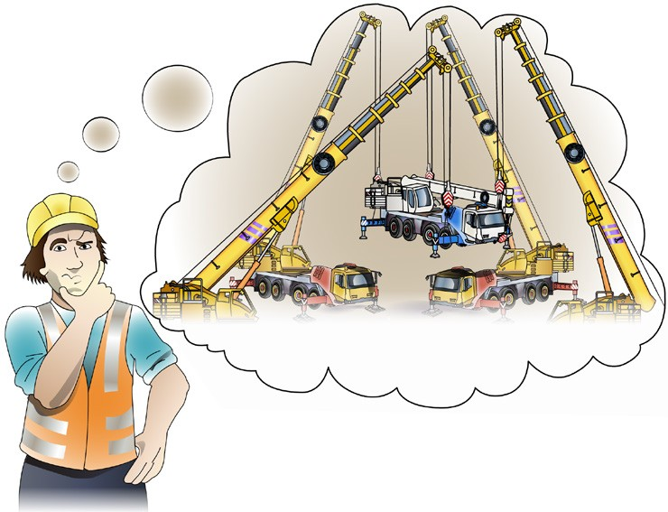

PC 1.1
PLAN JOB
QUESTION 9
...CONTINUED FROM PREVIOUS PAGE
You will plan for site hazards later.
What other things do you plan for before starting
a task?
What equipment do you need for the task? | Is the equipment available and suitable for the job?
What is the size and mass of the load? | What is the mass of the required lifting gear?
 |  | ...CONTINUES ON NEXT PAGE

Slide 8
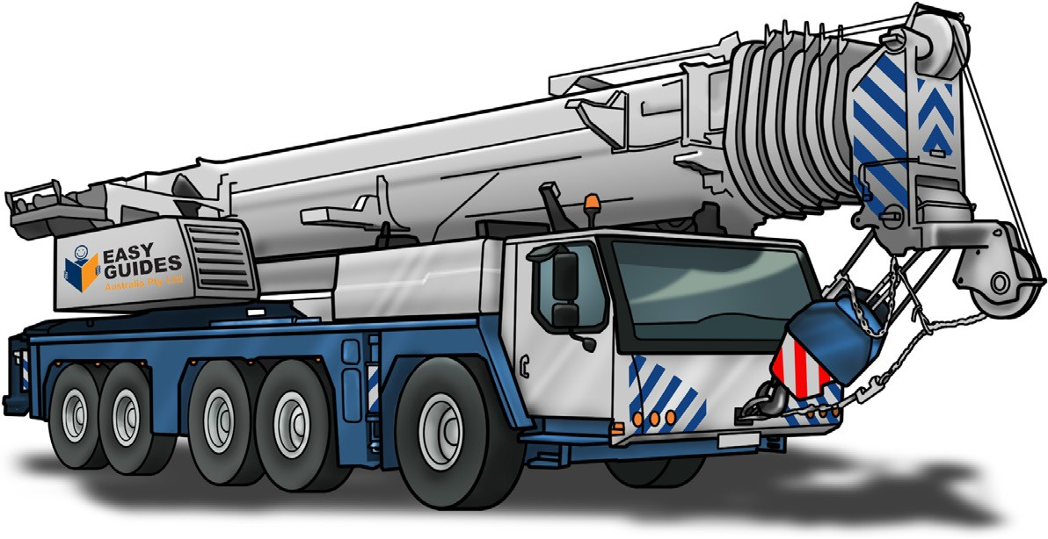
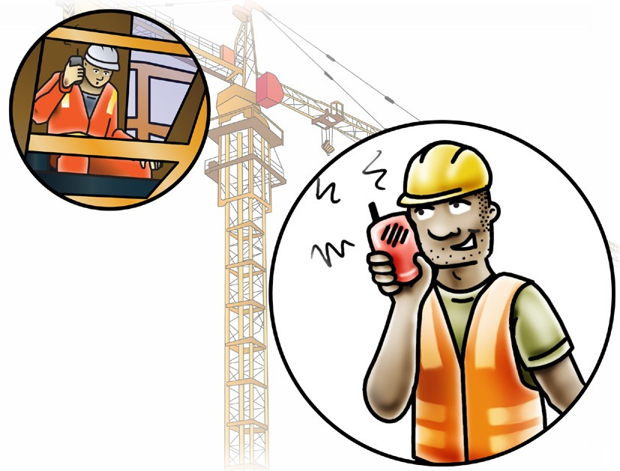
PC 1.1
PLAN JOB
 | QUESTION 9 |  | Have you chosen crane/s with the right capacity?
...CO | NTINUED FROM PREVIOUS PAGE
 | You will plan for site hazards later.
 | What other things do you plan for before starting a task?
 |  |  | What communication methods will you use to do the job safely?
 |  |  | For example,
 |  |  | Hand signals: If you can see the crane driver at all times.
 |  |  | Whistle signals: If you cannot always see the crane driver.
 |  |  | Fixed channel radio: If the site is noisy (fixed change two-way radios stop others from interfering with your instruments).

Slide 9
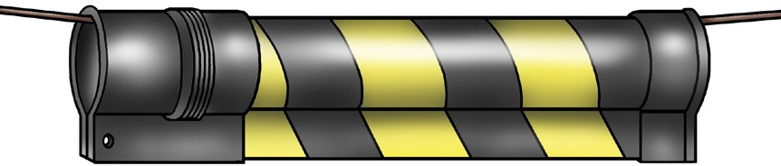
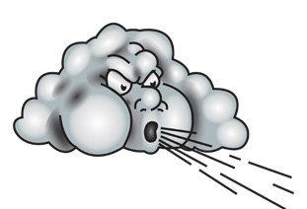
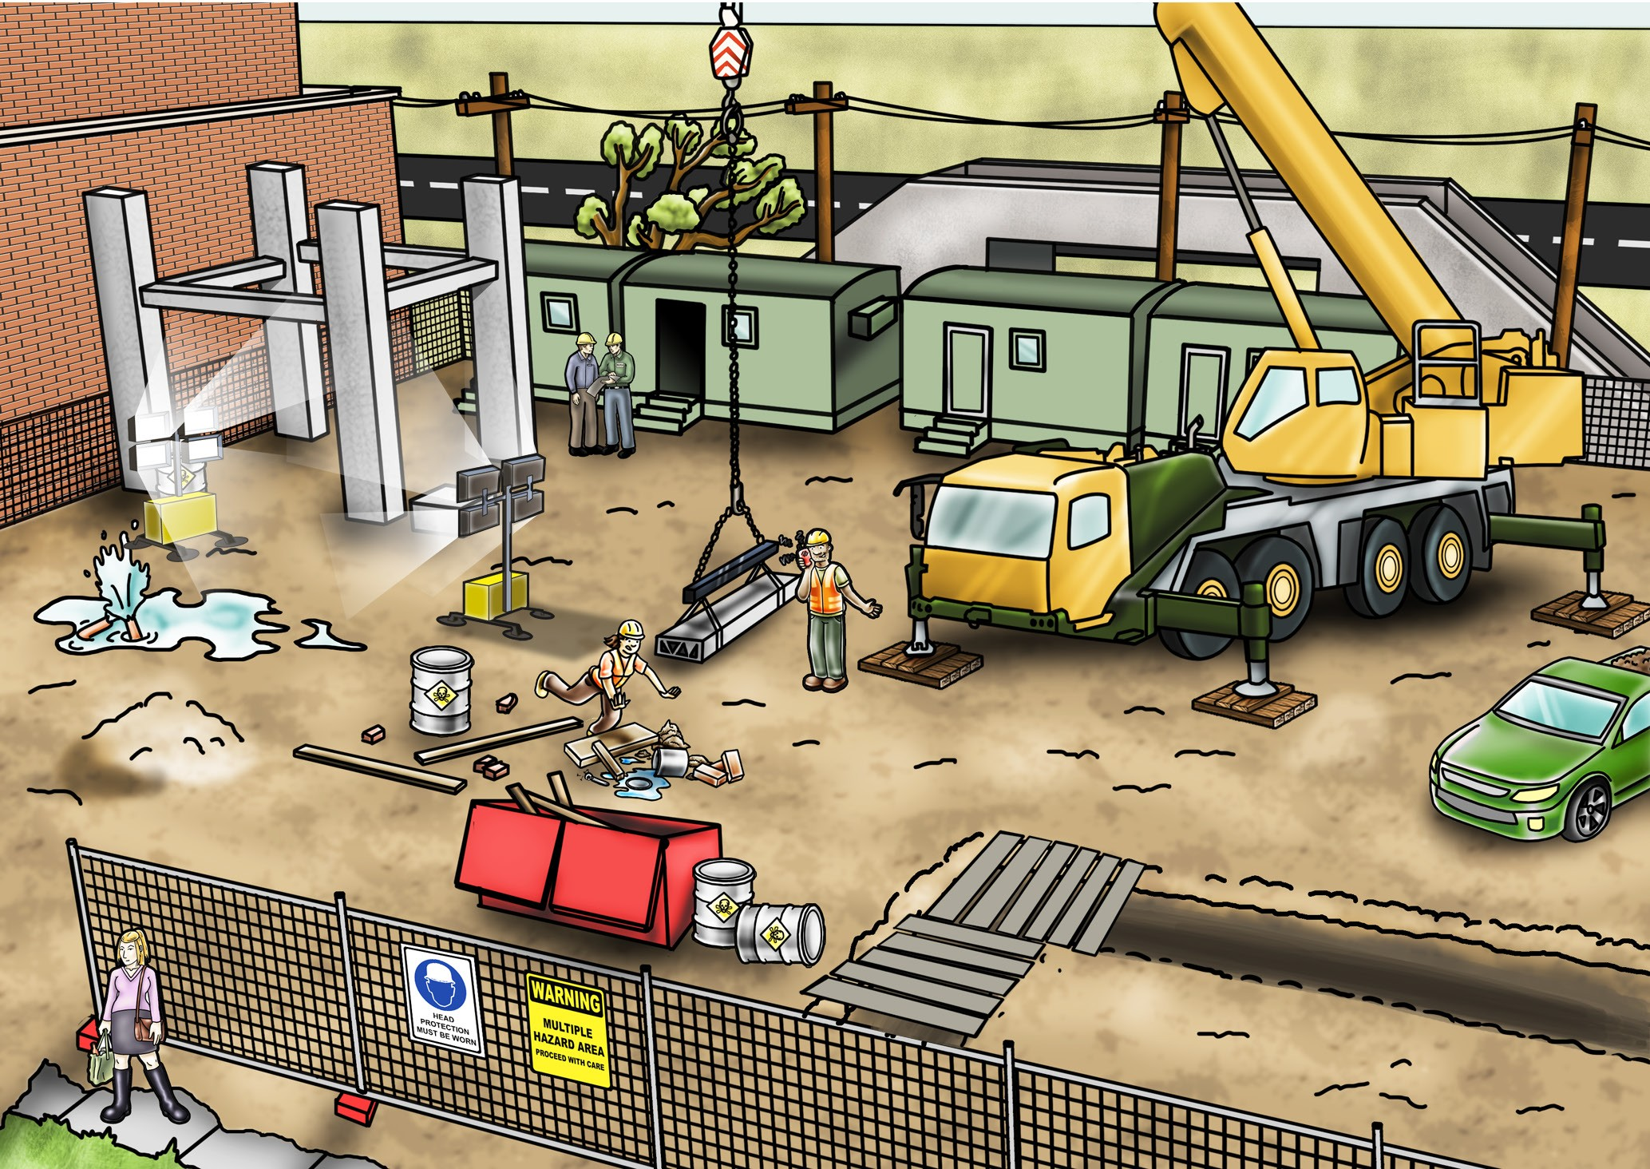
PC 1.2
PLAN JOB
QUESTION 10
What are tiger tails for?
Tiger tails show where power lines are.
QUESTION 11
What hazards (dangers) might you find at the worksite when doing rigging work?
Wind, lightning or rain
Trees
Powerlines
Surrounding buildings or obstructions
Bridges
Lighting
Vehicles/other
mobile plant/traffic
Underground services
Unstable ground
Hazardous materials
Tripping hazards
Recently
backfilled
trenches
Non weight bearing surfaces
Open trenches/ excavations
Pedestrians

Slide 10
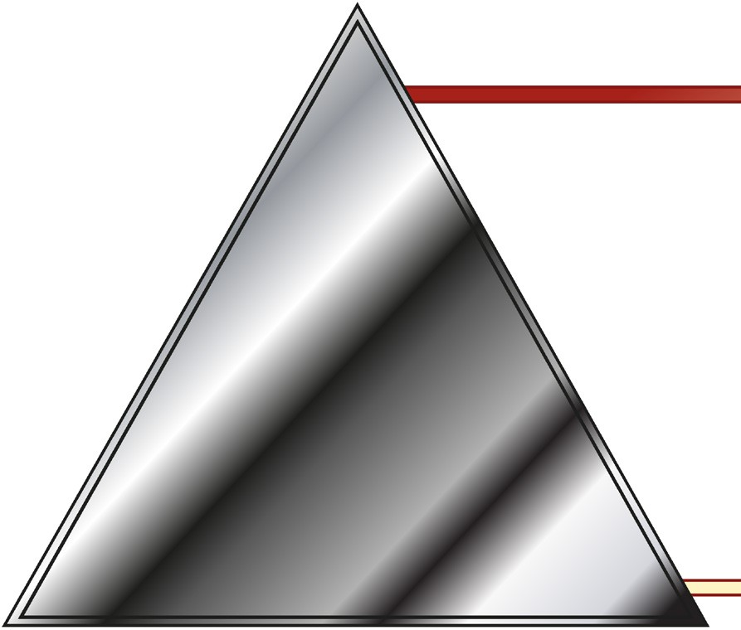
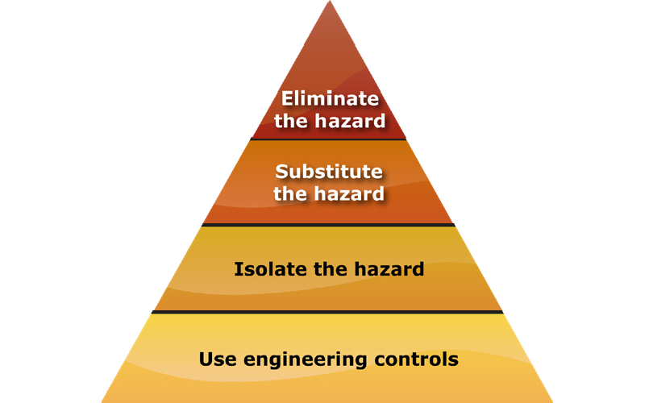
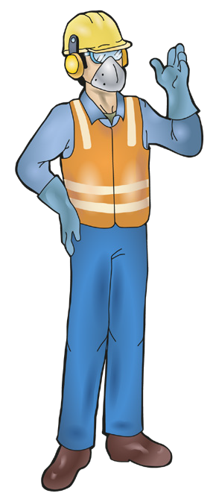
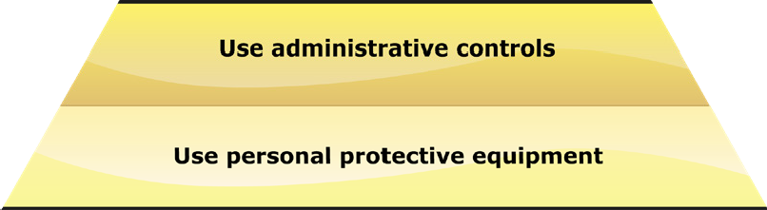
PC 1.3
PLAN JOB
QUESTION 12
The Hierarchy of Hazard Control is a list of controls that you can use to eliminate or lower the danger from a hazard in the workplace.
What are the six (6) levels in the hierarchy from the first choice to the last choice?
1. Elimination: If possible, remove (take away)
the hazard.
2. Substitution: Use a safer method if you can’t remove the hazard.
3. Isolation: Stop access to the hazardous (dangerous) area.
4. Engineering Control Measures:
Change the tools, equipment or environment to make it safer.
5. Administrative Practices: Reduce the time the worker is exposed to the hazards by using training, job rotation, the timing of jobs, etc.
6. Personal Protective Equipment (PPE): Use PPE as your last line of defence.
Memory aid: Every Saturday I Eat A Pie

Slide 11
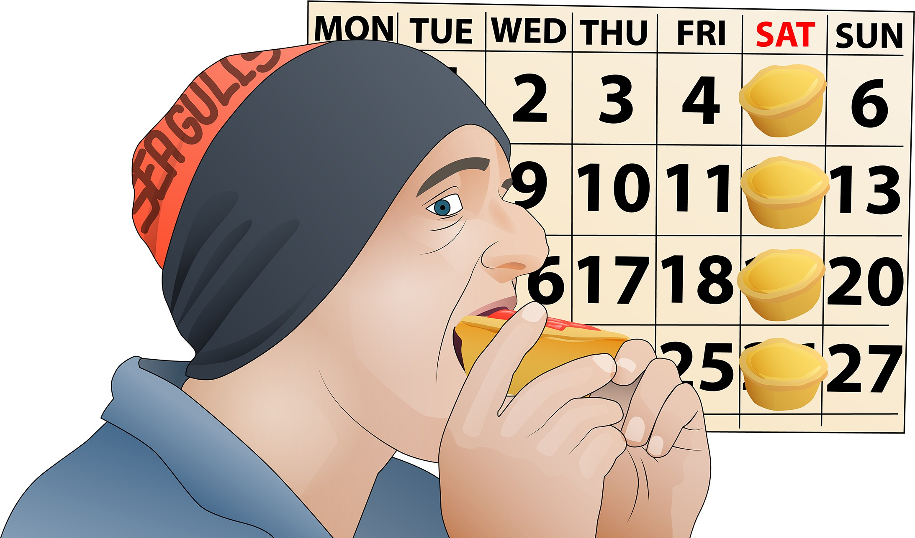
PC 1.3 PLAN JOB
How to remember the Hierarchy of Hazard Control
You can use the following acronym (an abbreviation formed from the initial components in a phrase) to help you remember the steps in the hierarchy of hazard control.
Every Saturday I Eat a Pie
E Every
Eliminate
S Saturday
Substitute
I
I
Isolate
E Eat
Engineering
A a
Administration
P Pie
PPE

Slide 12
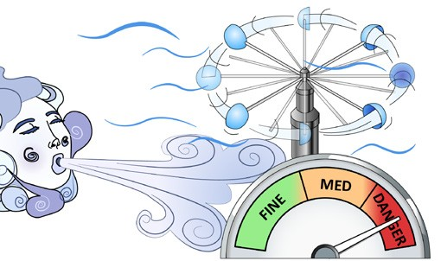
PC 1.3
PLAN JOB
QUESTION 13 What standards and processes can you use to control the hazard of high wind (wind load)? | Make sure crane drivers know the crane’s ability in high wind. Find out about wind using: AS 2550 Cranes, hoists and winches – Safe Use the crane’s load chart the crane’s operating manual other manufacturer’s information. Have a worksite policy. If it is very windy, stop crane lifts and working at heights.
 |  | Beaufort Scale Number | Description | Unit in kms/h | Description for land
 |  | 0 | Calm | 0 | Smoke rises vertically
 |  | 1 - 3 | Light winds | 19 km/h or less | Wind felt on face Leaves rustle Ordinary vanes moved by wind
 |  | 4 | Moderate winds | 20 - 29 km/h | Raises dust and loose paper Small branches are moved
 |  | 5 | Fresh winds | 30 - 39 km/h | Small trees (in leaf) begin to sway Crested wavelets form on inland waters
 |  | 6 | Strong winds | 40 - 50 km/h | Large branches in motion Whistling heard in telephone wires Umbrellas used with difficulty
 |  | 7 | Near gale | 51 - 62 km/h | Whole trees in motion Inconvenience felt when walking against wind

Slide 13
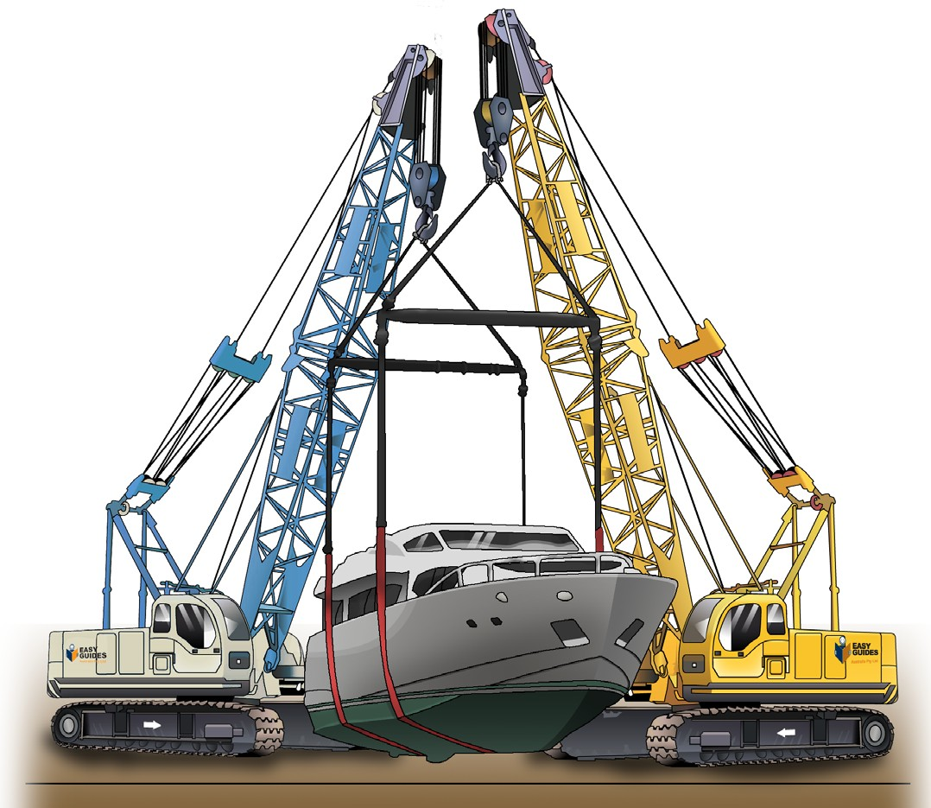
PC 1.3
PLAN JOB
QUESTION 14 | A Safe work method statement (SWMS) is a document that:
What is meant by a crane lifting plan (sometimes known as a safe work method statement)? | lists the types of high risk construction work being done states the health and safety hazards and risks arising from that work describes how the risks will be controlled describes how the risk control measures will be put in place.
 | AS 2550 suggests planning for crane work should begin as soon as possible. The plan should include how cranes will get into the site, making sure the ground or supporting structure can support the crane, what loads will be lifted and where they will be lifted to.

Slide 14
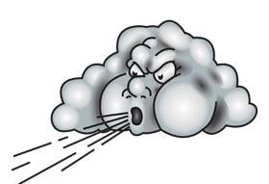
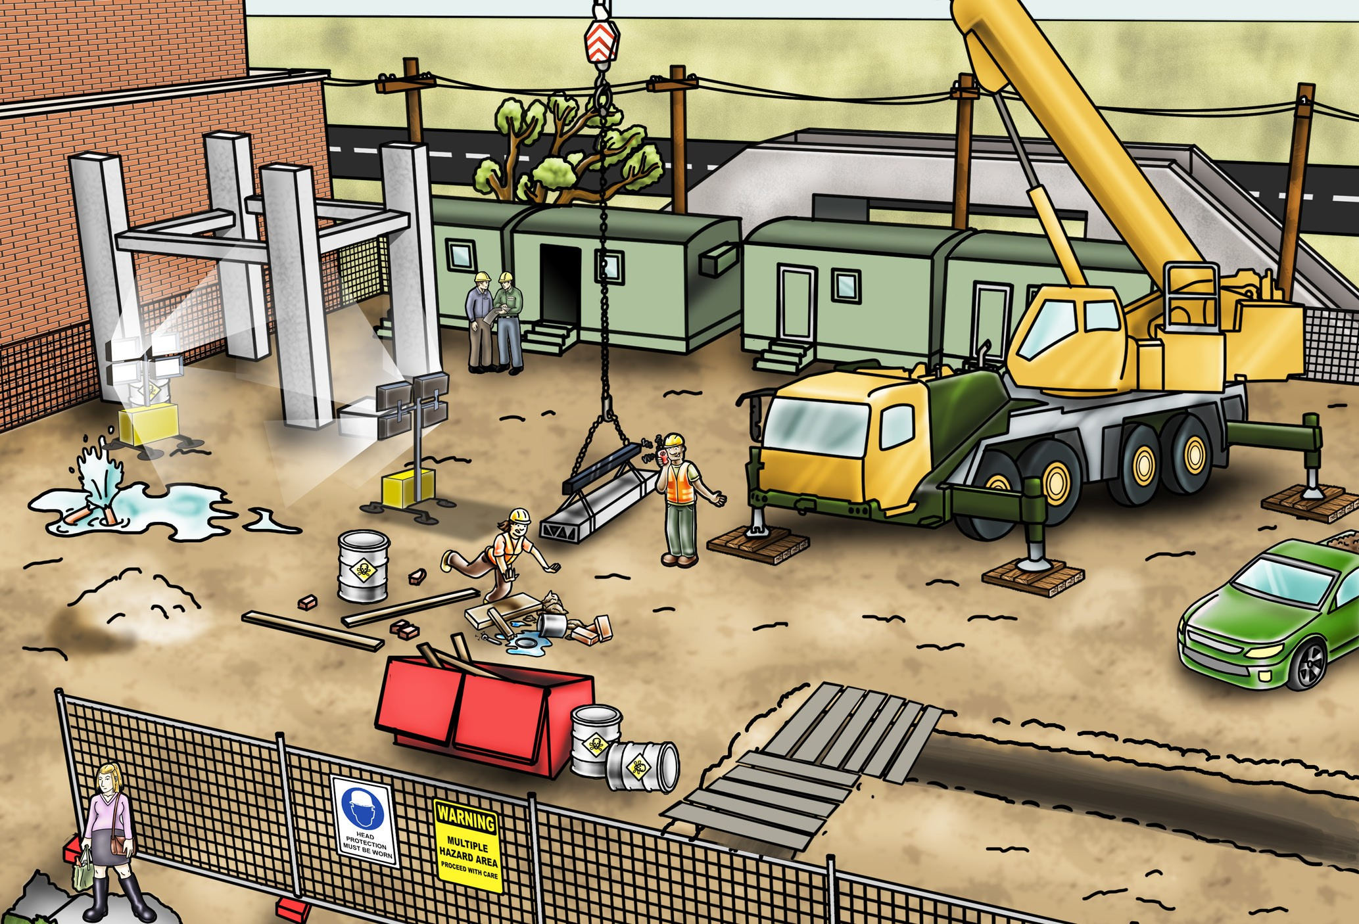
PC 1.3
PLAN JOB
QUESTION 15
Description of worksite:
It is a large industrial site and other companies and people are also using the site
A mobile crane is already operating
The site is new and has underground services.
What are some common hazards you might find at the worksite?
How do you control some of these hazards?
Surrounding structures and facilities
Surrounding buildings or obstructions
Wind, lightning or rain
Powerlines and overhead services
Trees
Bridges
Underground services
Lighting
Vehicles/other mobile plant/equipment
Tripping hazards
Hazardous materials
Unstable ground
Open trenches/ excavations
Non-weight bearing surfaces
Recently backfilled trenches
Pedestrians
...CONTINUES ON NEXT PAGE

Slide 15
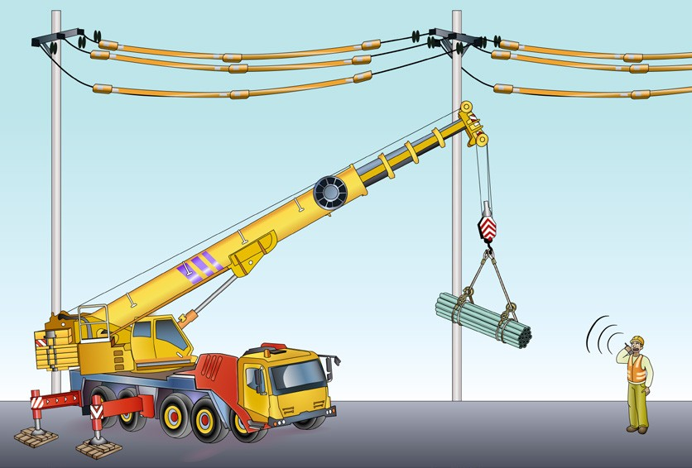

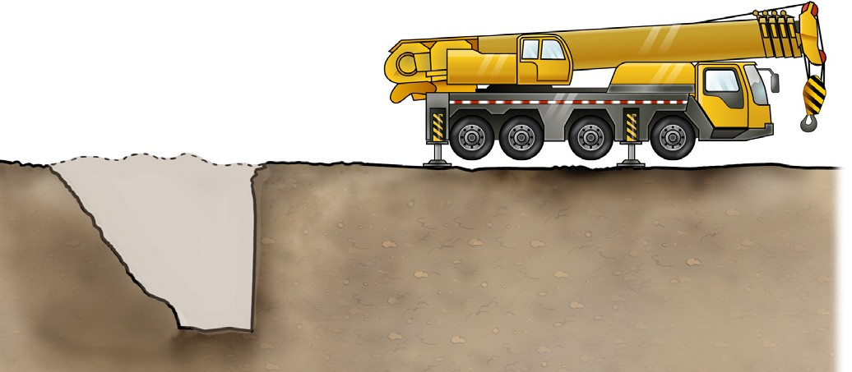
PC 1.3
PLAN JOB
QUESTION 15
...CONTINUED FROM PREVIOUS PAGE
Description of worksite:
It is a large industrial site and other companies and people are also using the site
A mobile crane is already operating
The site is new and has underground services.
What are some common hazards you might find at the worksite?
How do you control some of these hazards?
Hazard: Power lines and overhead service lines (for example, cable TV). Hazard control: Crane lift plan must allow for safe distances. In some states, you can use a spotter to work closer. Spotter
Hazard: Ground conditions, for example, if there have been recent excavations (trenches dug and filled in) for underground services. Hazard control: Set up the cranes at a safe distance from trenches or soft ground. A general rule is however deep the trench was or is, be at least that far away. For example, if the trench is one metre deep, cranes should be one metre or more away from the trench (the 1 to 1 rule). Always ask the engineer if unsure. 1 m 1 m
 | ...CONTINUES ON NEXT PAGE

Slide 16
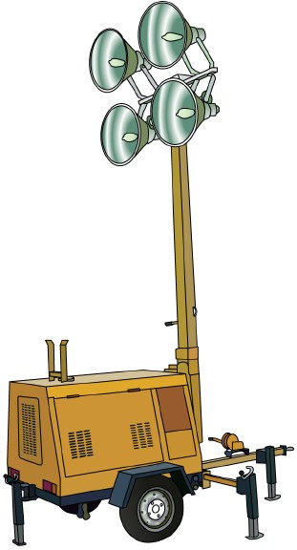
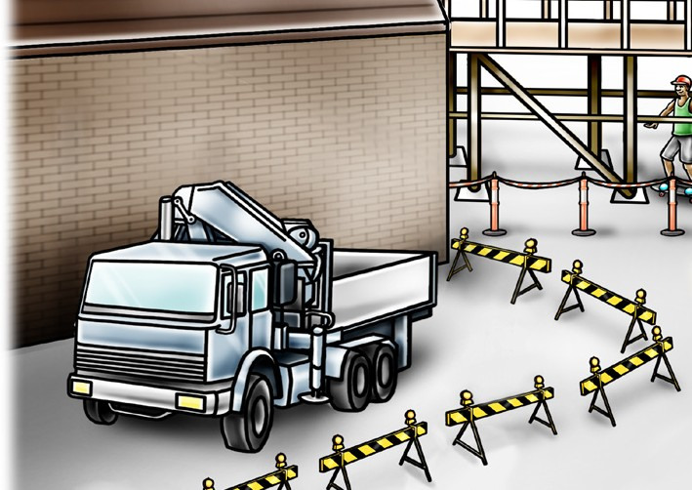
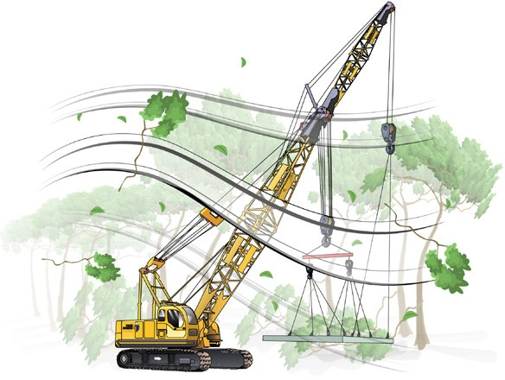
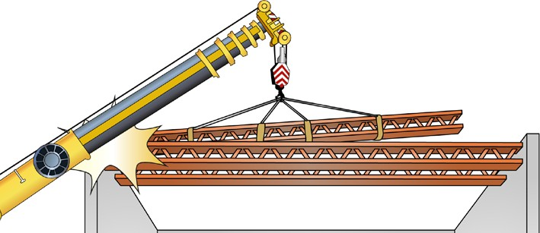
PC 1.3
PLAN JOB
QUESTION 15
...CONTINUED FROM PREVIOUS PAGE
Description of worksite:
It is a large industrial site and other companies and people are also using the site
A mobile crane is already operating
The site is new and has underground services.
What are some common hazards you might find at the worksite?
How do you control some of these hazards?
Hazard: Poor lighting. Hazard control: Make sure lighting is adequate. Set up light towers if necessary. | Hazard: Pedestrians and other workers. Hazard control: Set up barriers and exclusion zones.
Hazard: Wind, bad weather and trees. Hazard control: Check the lift plan or SWMS as well as the cranes limitations for working in bad weather conditions (eg: wind rating). | Hazard: Buildings, bridges, surrounding structures and obstructions. Hazard control: Crane lift plan must make sure that all parts of the crane or cranes and load are kept clear. Maintain a safe distance and operating radius.
 |  | ...CONTINUES ON NEXT PAGE

Slide 17
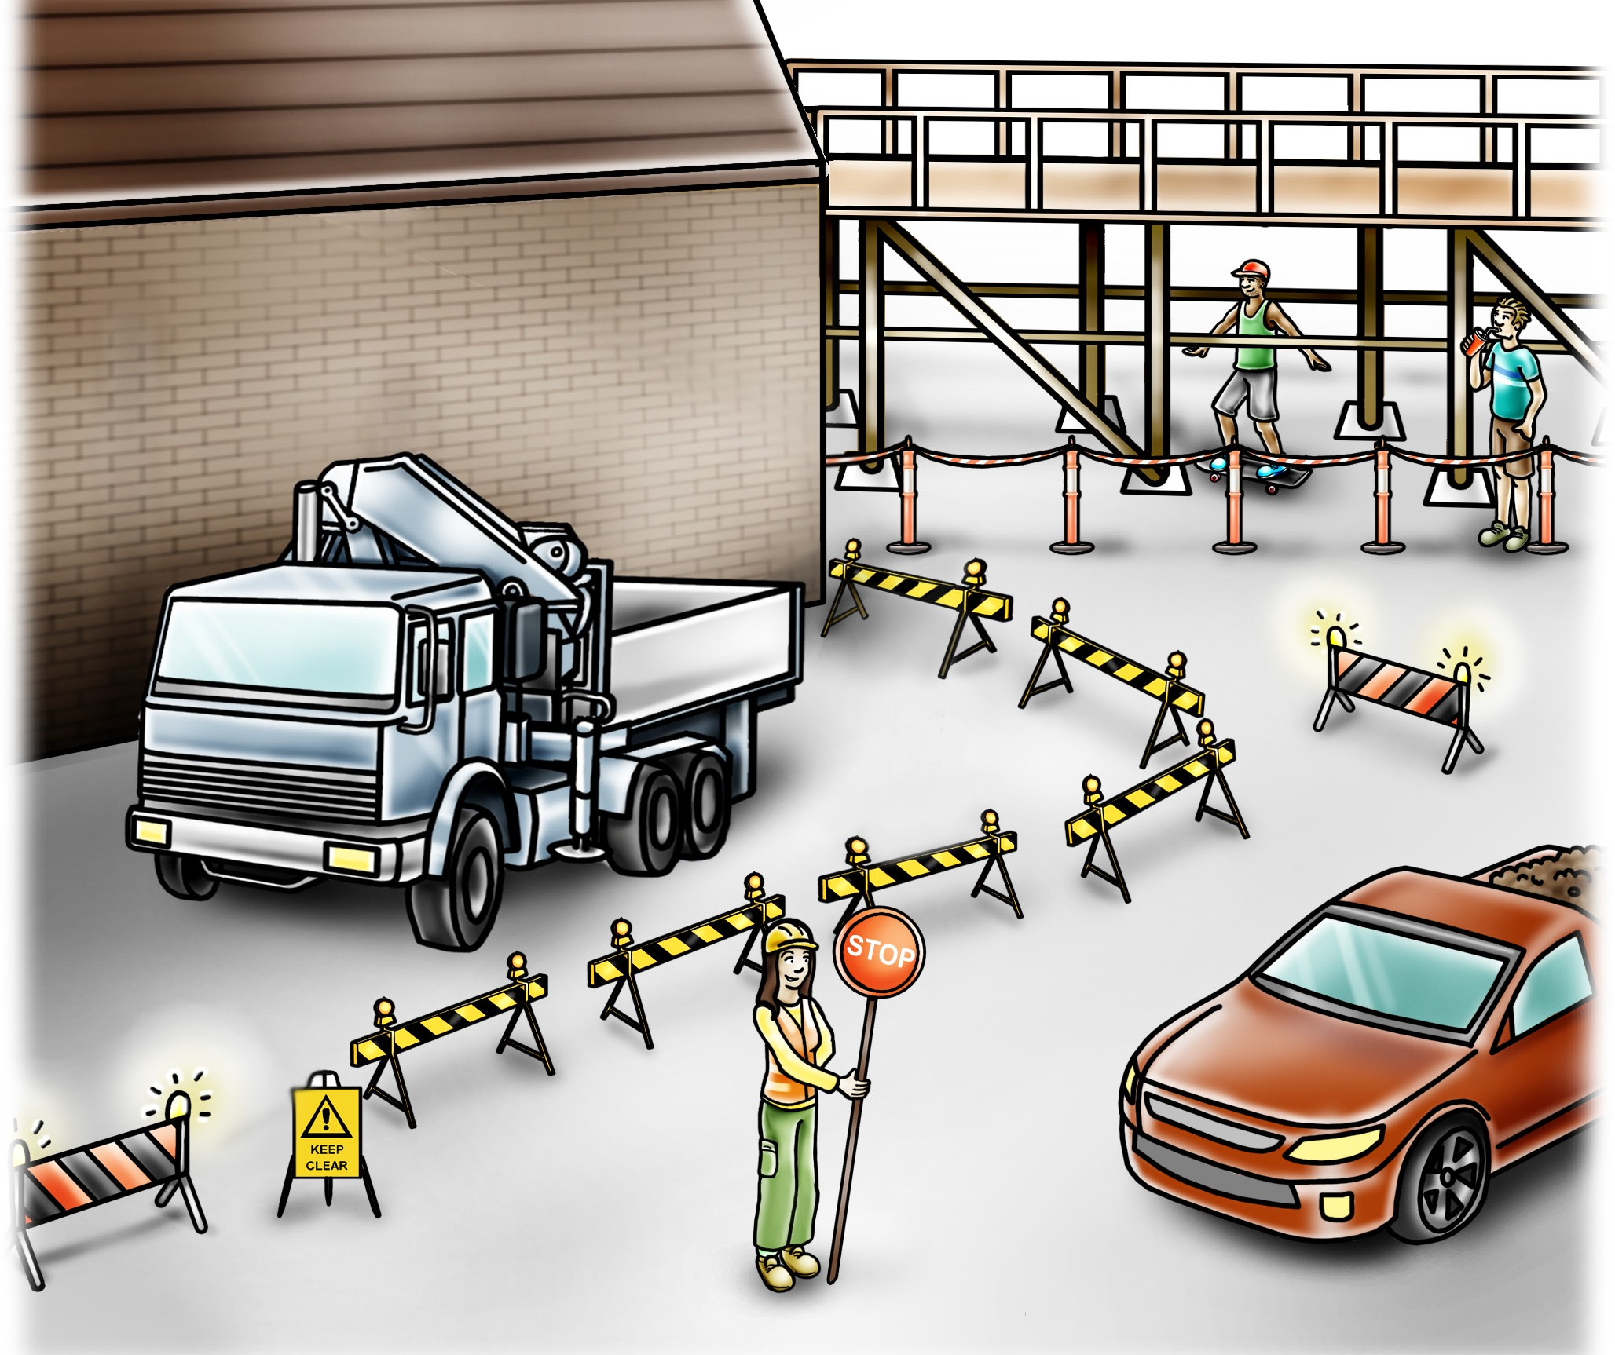
PC 1.3
PLAN JOB
QUESTION 15
Hazard: Plant and equipment.
Hazard control: Set up barriers and exclusion zones. Also consider using a worker
to manage and control the traffic.
...CONTINUED FROM PREVIOUS PAGE
Description of worksite:
Scaffolding or a gantry to protect people
Flashing yellow hazard lights to warn people
It is a large industrial site and other companies and people are also using the site
A mobile crane is already operating
The site is new and has underground services.
Traffic control such
as barricades
What are some common hazards you might find at the worksite?
How do you control some of these hazards?
Pedestrian exclusion zone
A flag person to control the traffic
Warning signs

Slide 18
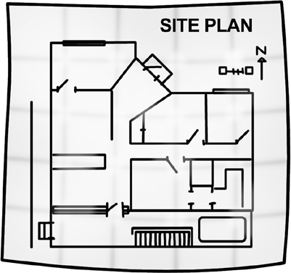
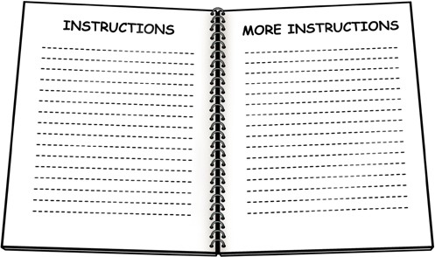

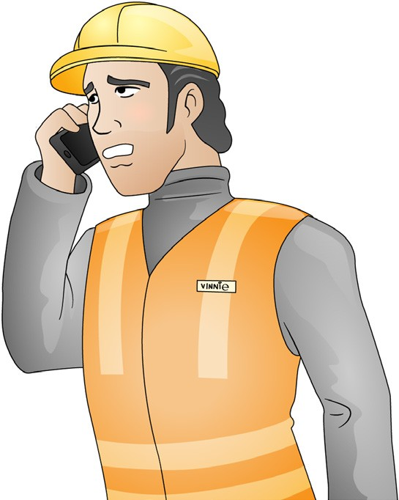
PC 1.4
PLAN JOB
QUESTION 16 Before you begin working on a new site, what sort of information do you need from the safety officer, engineer (if available), and supervisor? | Safety officer: Site hazards, hazard controls for the site, safety policies for the site. Engineer: Site plans and drawings, load bearings details such as soil bearing pressure forces in a structure. Supervisor: Job instructions, local information about the site, other contractors and work area arrangements.
QUESTION 17 How do you get information about nearby powerlines, for example powerline voltage? | Contact the local electricity supply authority.

Slide 19
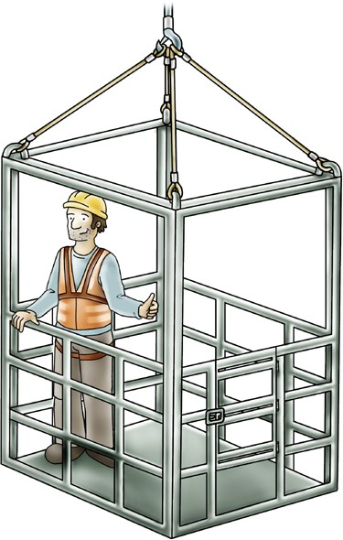
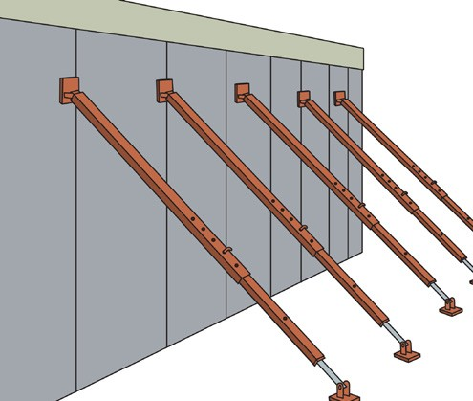
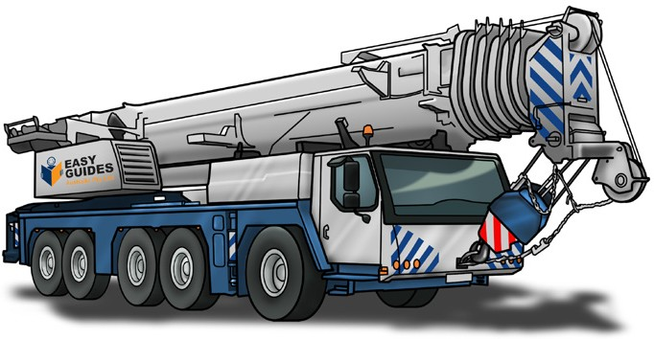
PC 1.5
PLAN JOB
QUESTION 18
Explain what is meant by the following forces and loads:
Dead loads
Live loads
Static load
Dynamic force
Wind loads.
Give an example of each.
Live loads The load being lifted by a crane or hoist. It includes anything hanging from the boom (for example, hook blocks, slings etc.) For example, a qualified rigger being lifted in a work box built to Australian Standards or a tilt-up concrete panel being lifted by a crane.
Dead loads The actual weight of a crane before it is loaded. For example, a large mobile crane. | Static load A load that is at rest and applies consistent (steady) downward pressure only. For example, the weight imposed on a structure by concrete panels.
 |  | ...CONTINUES ON NEXT PAGE

Slide 20
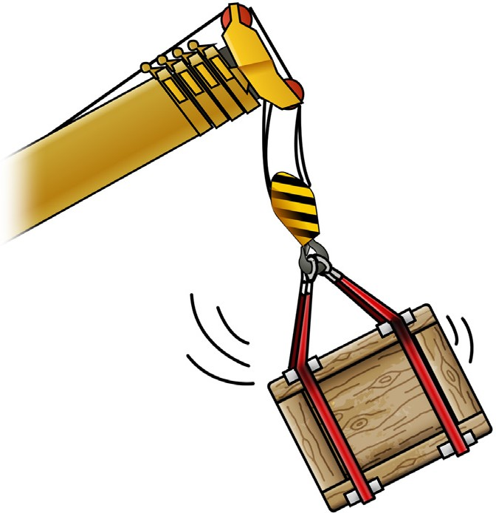
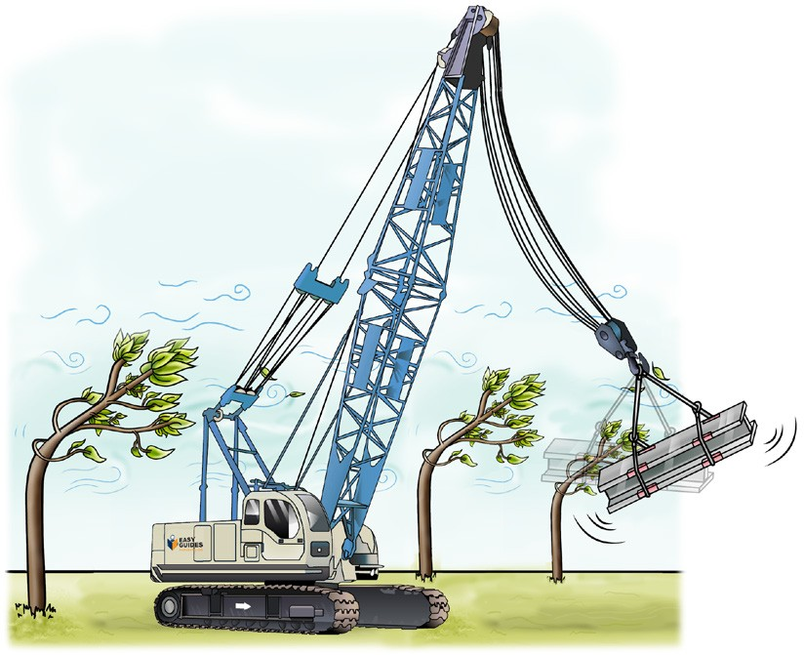
PC 1.5
PLAN JOB
 | QUESTION 18 |  | Dynamic force A force created by movement or change. For example, a crane and load moving.
...CO | NTINUED FROM PREVIOUS PAGE
 | Explain what is meant by the following forces and loads:
 | Dead loads
 | Live loads
 | Static load
 | Dynamic force
 | Wind loads.
 | Give an example of each.
 |  |  | Wind loads The total force applied by the wind on a load, crane or structure.
 |  |  | For example, the manufacturer of a crane should provide details about the highest wind force a crane can work in.

Slide 21
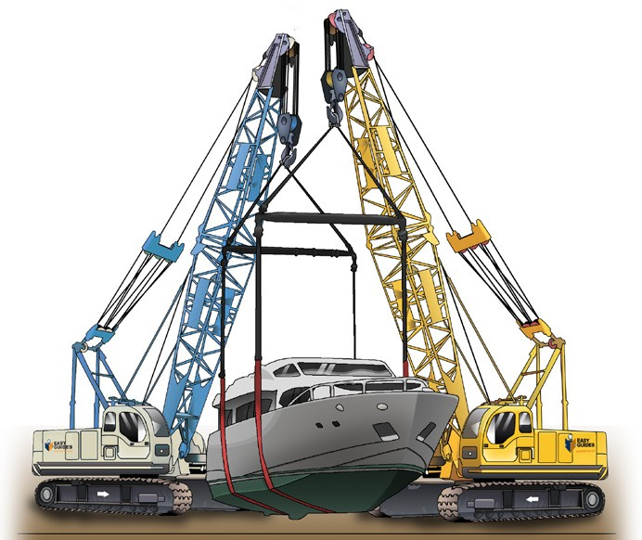
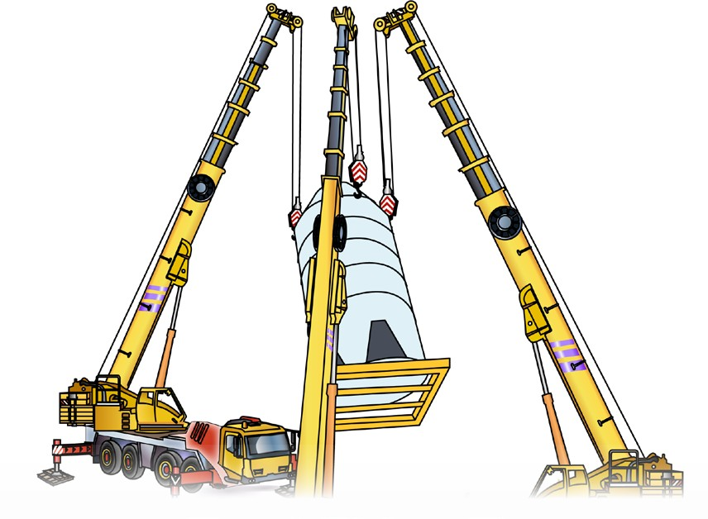
PC 1.5
PLAN JOB
QUESTION 19
You need to plan for a two-crane (dual) lift.
Assume that each crane will have equal lifting capacity at the required radius. Each crane must lift 10 tonnes.
What is the minimum lifting capacity each crane will need?
When two cranes are used, the minimum capacity of each crane must be 20% more than its share of the load.
Minimum crane capacity
= Load + 20% of Load
= 10 + (10 × 20%)
= 12 tonne minimum capacity per crane
QUESTION 20
You need to plan for a three-crane lift. Assume that each crane will have equal lifting capacity at the required radius. Each crane must lift 15 tonnes.
What is the minimum lifting capacity each crane will need?
When three cranes are used, the minimum capacity of each crane must be 33% more than its share of the load.
Minimum crane capacity
= Share of Load + 33% of Load
= 15 + (15 × 33%)
= 20 tonne minimum capacity per crane
45 tonne

Slide 22
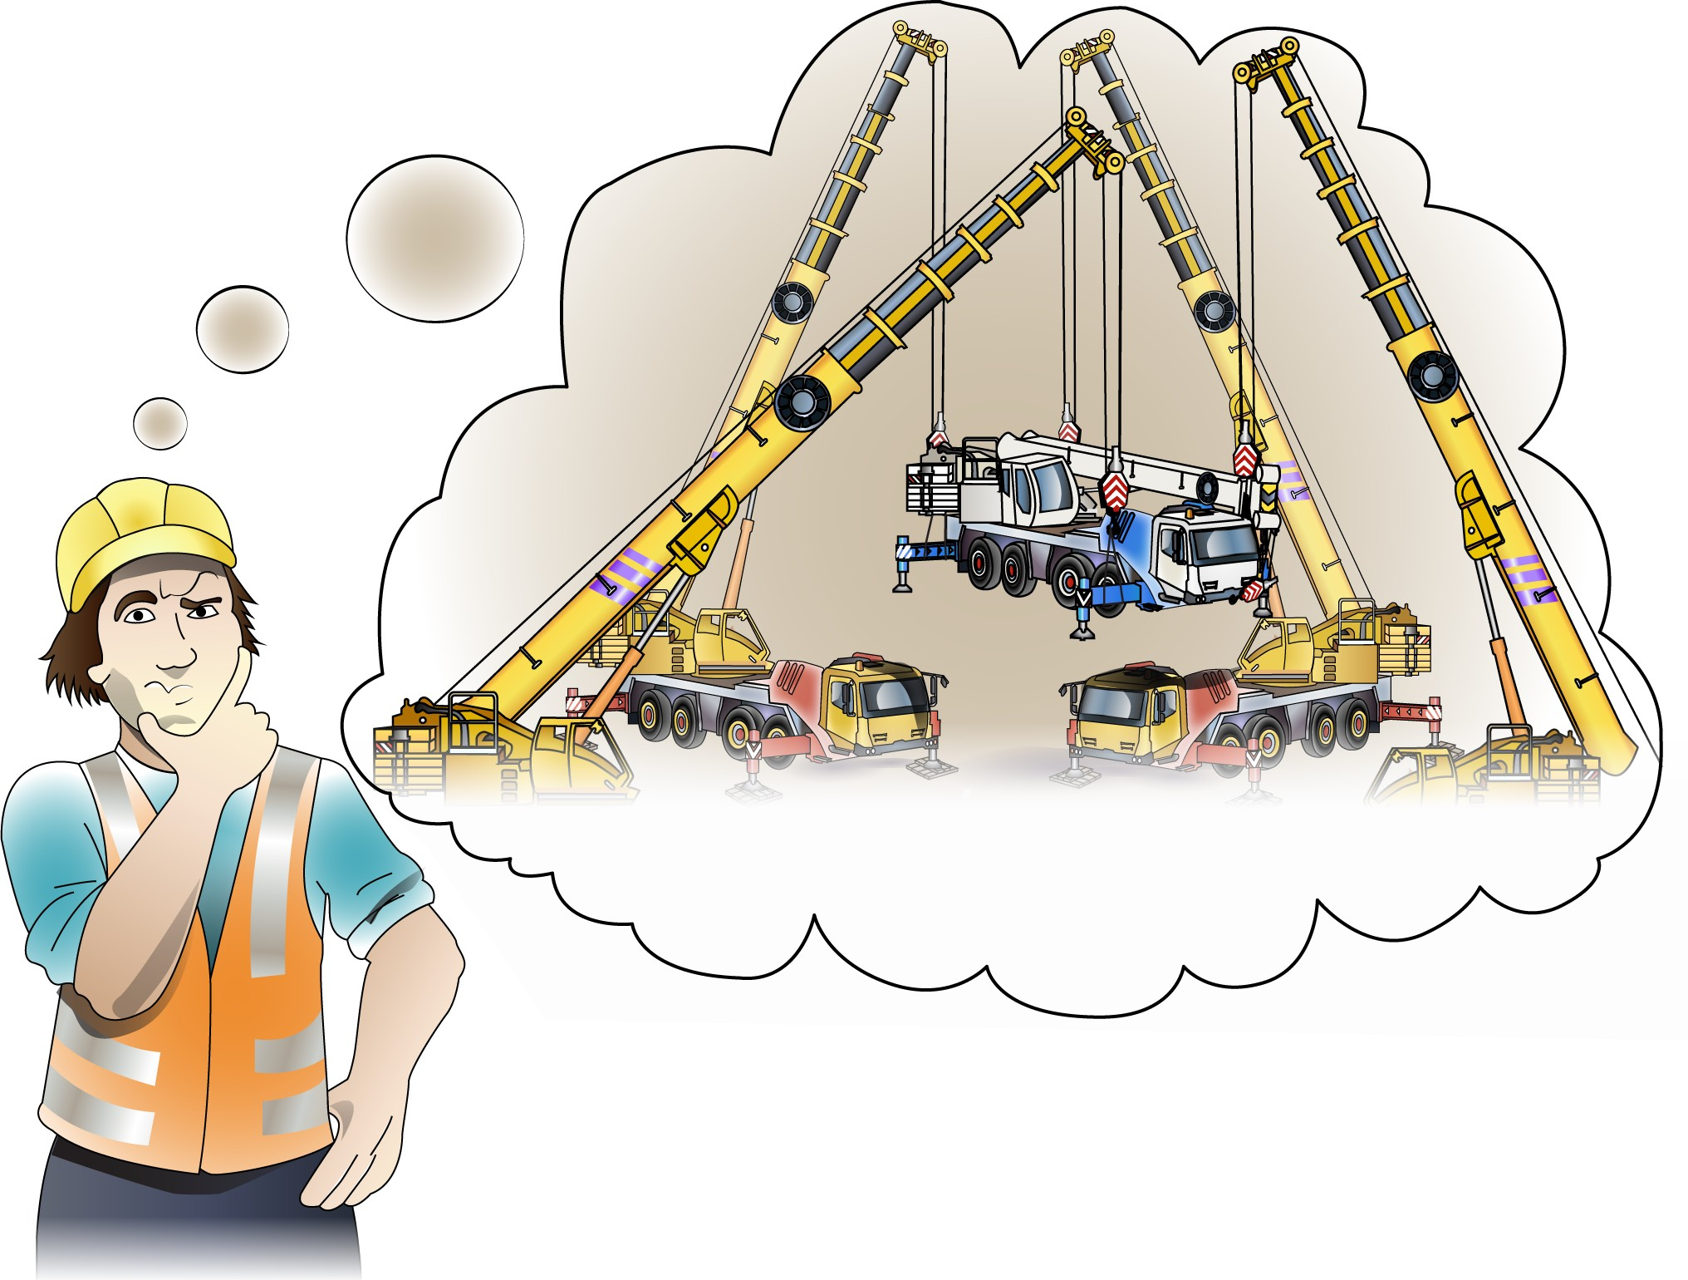
PC 1.5
PLAN JOB
QUESTION 21
You need to plan for a four-crane lift. Assume that each crane will have equal lifting capacity at the required radius. Each crane must lift 30 tonnes.
What is the minimum lifting capacity each crane will need?
When four cranes are used, the minimum capacity of each crane must be 50% more than its share of the load.
Minimum crane capacity
= Share of Load + 50% of Load
= 10 + (10 × 50%)
= 15 tonne minimum capacity per crane
40 tonne load

Slide 23
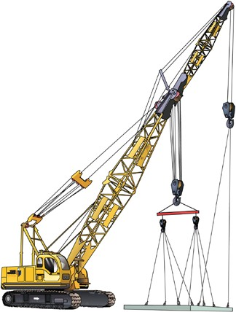
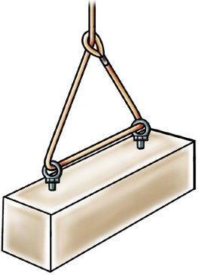
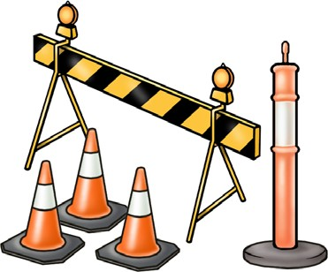
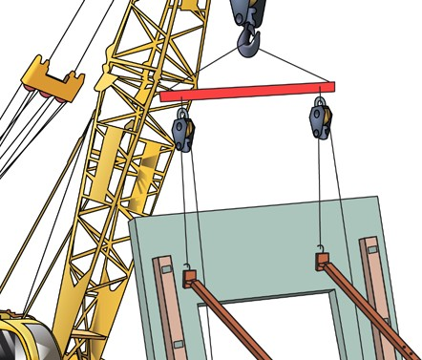





PC 1.6
PLAN JOB
QUESTION 22
What kind of rigging equipment and associated equipment would you need to erect a tilt slab building?
Cranes | Lifting equipment | Hazard (risk) controls
Lifting attachments for slabs | Braces | Lifting clutches (to lift tilt slabs)
Access equipment for working at heights. For example, EWP’s. | PPE | Communication equipment

Slide 24



PC 5.5, 5.6
DISMANTLE STRUCTURES AND PLANT
QUESTION 159 You have finished a job. You are taking down a structure. You find some damaged equipment. What must you do? | a) You must let others know there is damaged equipment so they won’t use it. For example, you can tag out the equipment. | b) You must also report the damage to your supervisor. Follow the rules for your site.
QUESTION 160 What is the correct way to store (put away) lifting equipment? | You should store lifting equipment in a dry, clean and well ventilated place with plenty of fresh air. Most work sites will use a rack to store lifting equipment. This protects slings from rust, mould and other water damage.
24

Slide 25


PC 5.7
DISMANTLE STRUCTURES AND PLANT
QUESTION 161 | Some things you might do are:
You have finished rigging work. | Put away barriers and bollards. Take down signs.
What do you have to do with the hazard prevention equipment?
 | Take down safety nets.
End of Dismantle structures and plant section. Check your knowledge by answering the questions at the end of the book. Your trainer will check your answers.
25

